Slide 1


Phonics at Home
How to Use 如果運用拼音教材
s
Put the mouse over a letter to 將滑鼠移到字母上便能聆聽
hear the sound. 該字母的發音。
Click a letter to see pictures 點一下字母便會看到相應的
and sounds. 圖片和聲音。
Press the mouse or space bar 點一下滑鼠或按一下空白鍵
to see the next page. 便會看到下一頁。
Click this logo to return to the 點這個鍵便返回主目錄。
home page.

Slide 2
ll
ss
zz
ff
sh
ch
th
wh
ck
ng
qu
x

Slide 3

ll
ba
ll
hi
ll
do
ll

Slide 4

ba
ll

Slide 5

hi
ll

Slide 6

do
ll

Slide 7
ss
ss
ki
ss
me
ss
dre

Slide 8

dre
ss

Slide 9

ki
ss

Slide 10

me
ss

Slide 11
ff
ff
cu
ff
sni
cli
ff

Slide 12

cli
ff

Slide 13

cu
ff

Slide 14

sni
ff

Slide 15
zz
zz
zz
pi
a
fi
bu
zz

Slide 16

bu
zz

Slide 17

pi a
zz

Slide 18

fi
zz

Slide 19
sh
sh
ell
sh
ip
fi
sh

Slide 20

sh
ell

Slide 21

sh
ip

Slide 22

fi
sh

Slide 23
ch
ch
ess
ch
ips
ch
air

Slide 24

ch
ess

Slide 25

ch
ips

Slide 26


ch
air

Slide 27
th
ba
th
th
umb
th
ink

Slide 28

ba
th

Slide 29

umb
th

Slide 30

ink
th

Slide 31
wh
wh
eel
wh
ite
wh
ale

Slide 32

wh
eel

Slide 33
wh
ite

Slide 34

wh
ale

Slide 35
ck
du
ck
so
ck
clo
ck

Slide 36

du
ck

Slide 37
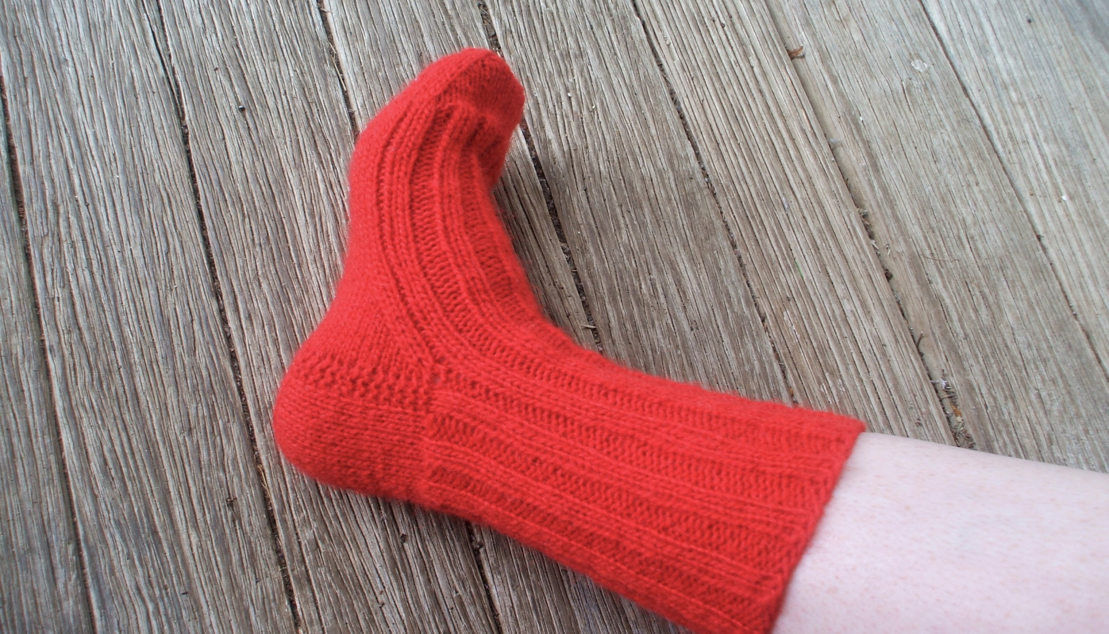
so
ck

Slide 38

clo
ck

Slide 39
ng
ng
si
ng
ri
swi
ng

Slide 40

si
ng

Slide 41

ri
ng

Slide 42

swi
ng

Slide 43
x
si
x
fo
x
x
bo

Slide 44
6
si
x

Slide 45

bo
x

Slide 46
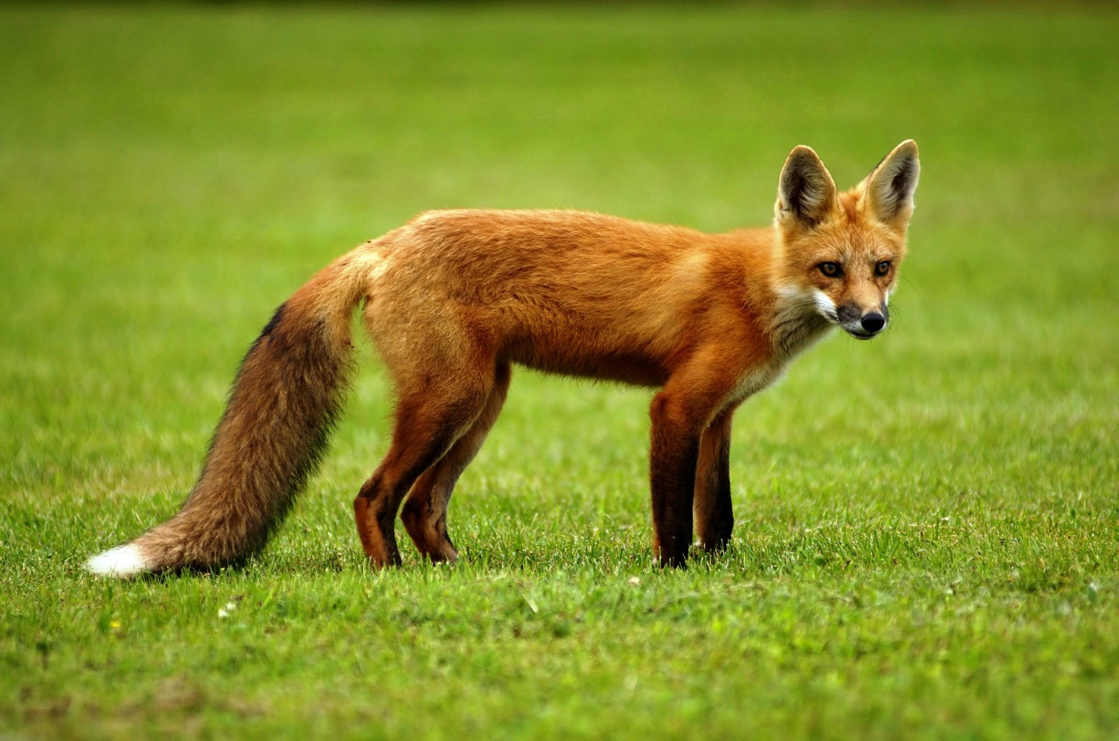
fo
x

Slide 47
qu
qu
een
qu
ilt
qu
iet

Slide 48

qu
een

Slide 49

qu
ilt

Slide 50

qu
iet

